Slide 1
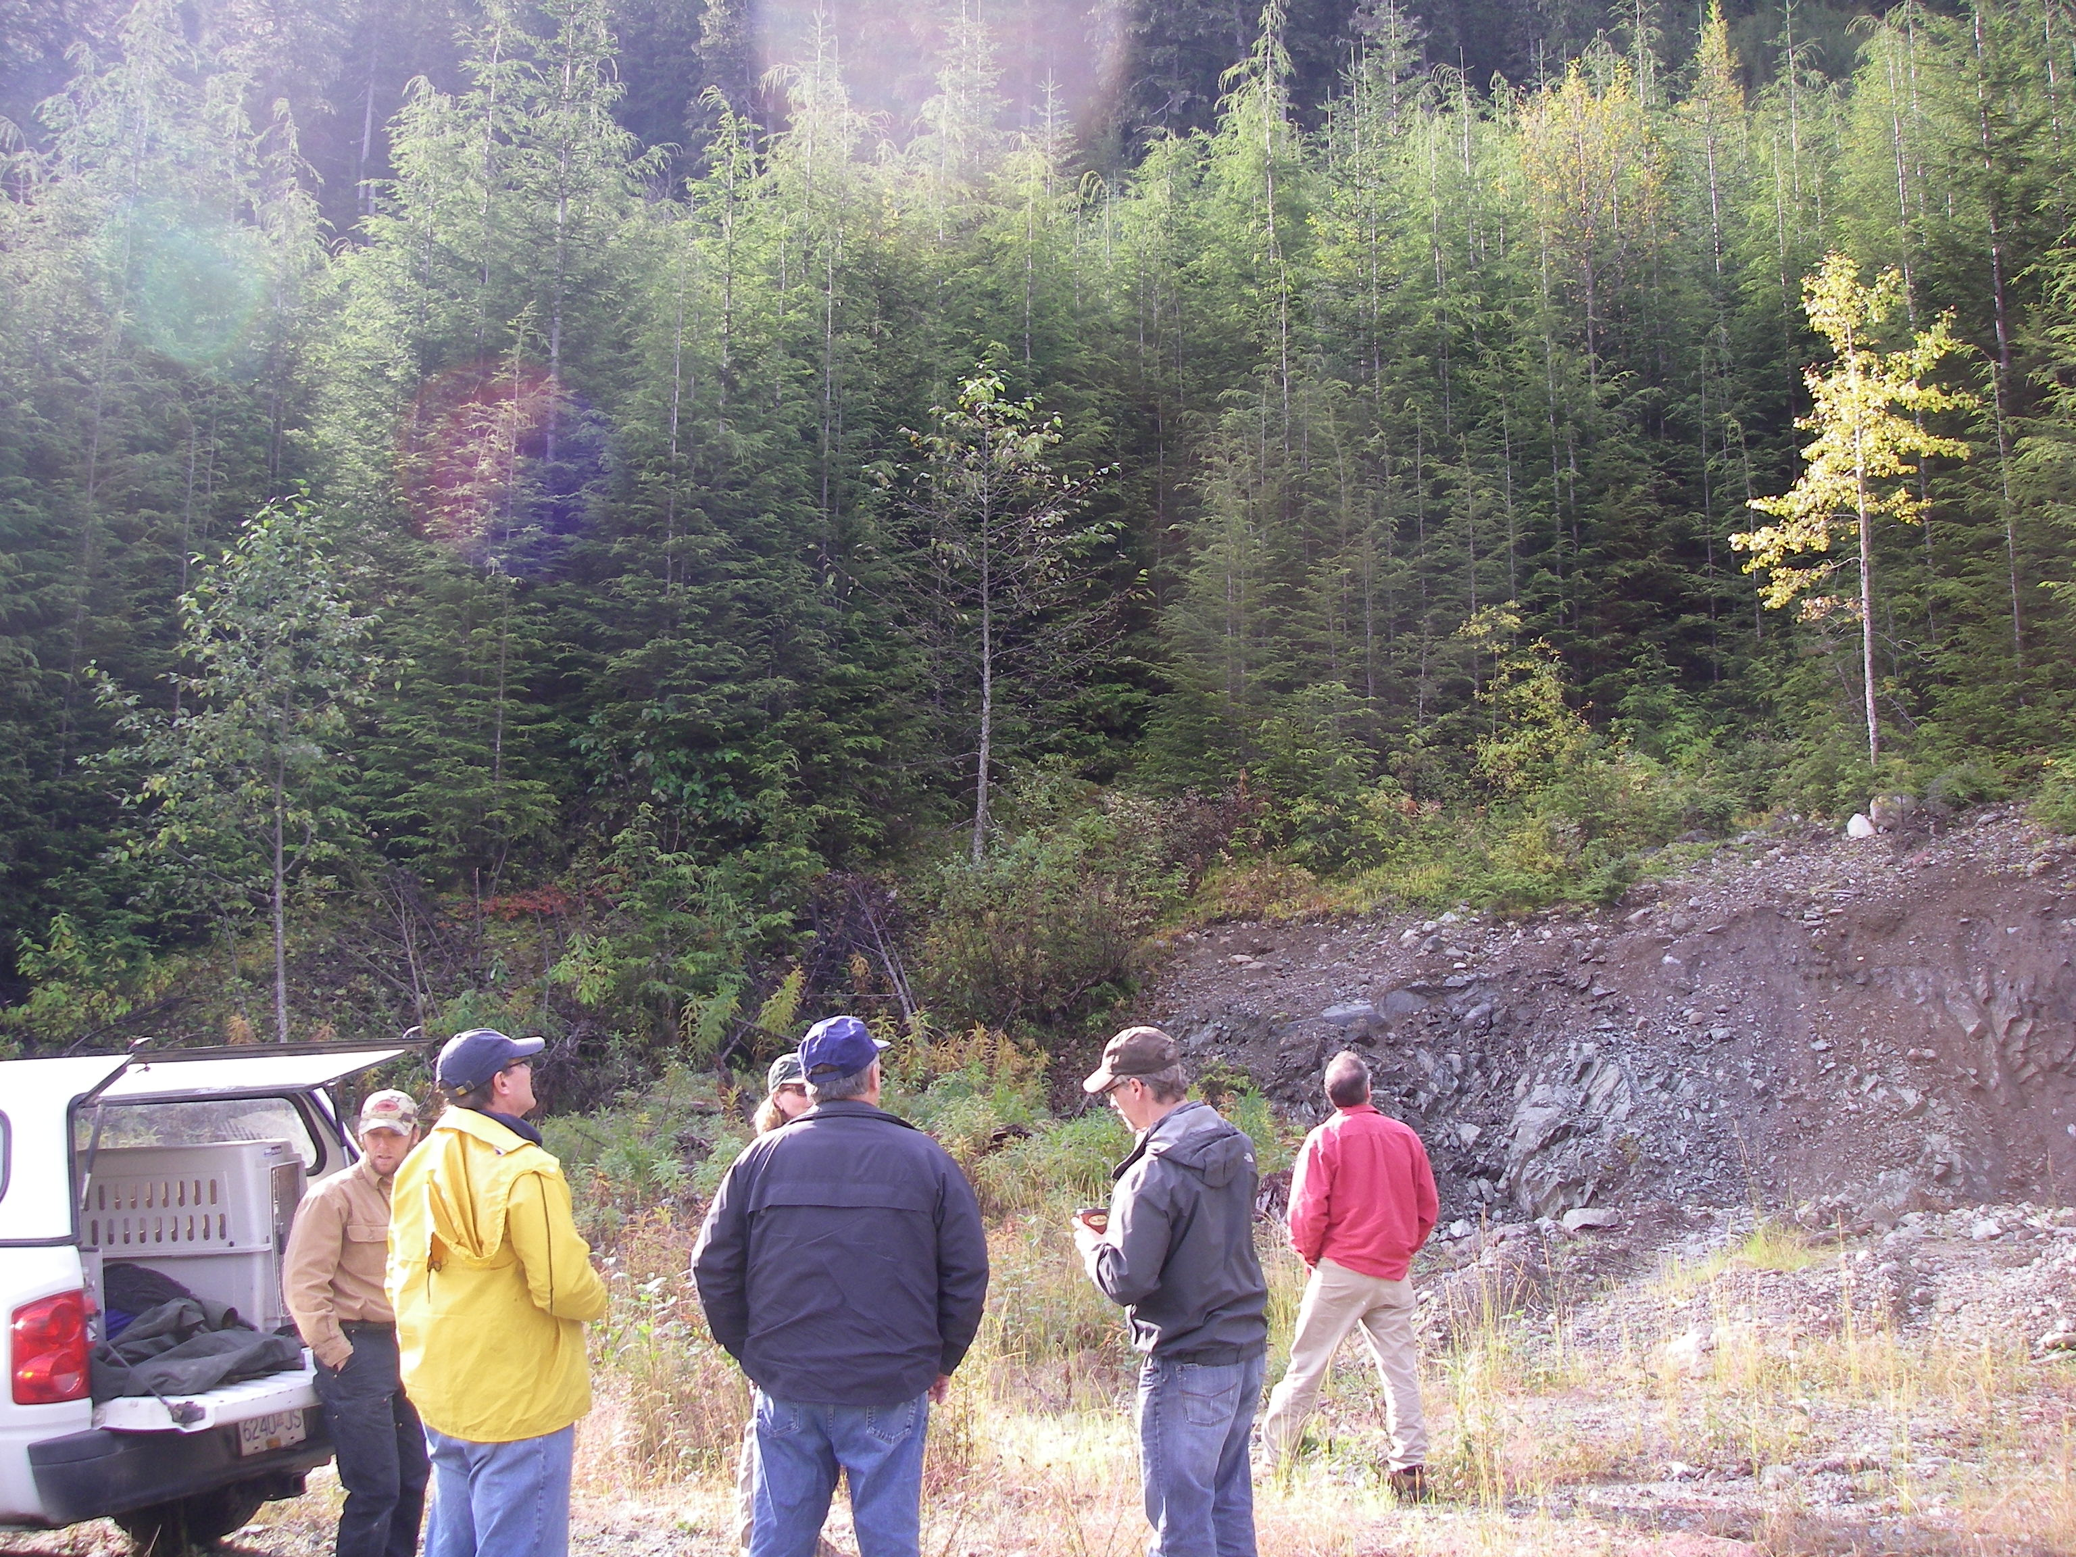
Kalum TSA
Mid-Term Timber Supply Issue

Slide 2
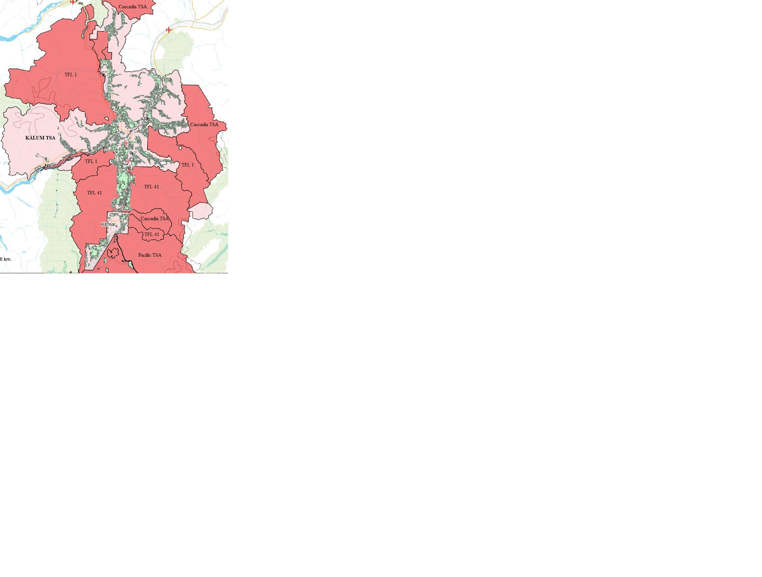

Slide 3
2010 TSR Kalum TSA
Timber harvesting land base
Land classification |  | Reduction area (ha) |  | Result (ha)
Gross TSA area |  |  |  | 2,300,464
Large parks |  |  | 460,845
Tree Farm Licences |  |  | 1,197,086
Nisga’a land |  |  | 119,821
Core TSA area |  |  |  | 522,712
Non‑forest |  |  | 327,026
Non-commercial area |  |  | 4,499
Ownerships not contributing to TSA forest management objectives |  |  | 32,870
Crown Forested Land Base |  |  |  | 158,318
Not managed by MFR¹ for TSA timber supply |  |  | 5,339
MFR Productive Forest |  |  |  | 152,979
 | Total |  | Removed
Avalanche areas | 1,057 |  | 1,057
Sensitive soils | 36,337 |  | 14,941
High recreation value | 393 |  | 393
Preservation VQO | 471 |  | 331
Inoperable areas | 15,471 |  | 10,796
Low timber growing potential | 21,413 |  | 15,187
Problem forest types
- aspen, birch, alder | 5,723 |  | 1,207
- open‑grown | 2,229 |  | 777
- stocking problems | 3,442 |  | 2,609
Wildlife habitat | 5,722 |  | 2,302
Cultural heritage areas | 132 |  | 132
Specific geographic areas
- Kalum SRMP no‑log zones | 1,302 |  | 1,123
- legal OGMAs | 9,890 |  | 4,878
- research & GY plots | 151 |  | 86
- Skeena Islands rare ecostems | 1,059 |  | 369
Riparian areas | 6,242 |  | 3,942
Wildlife tree patches |  |  | 5,326
Current roads |  |  | 2,697
Current Timber Harvesting Land Base |  |  |  | 84,826
Future roads |  |  | 4,006
Future Timber Harvesting Land Base |  |  |  | 80,820

Slide 4
Current age class distribution contains 2 spikes
Most of the forest is either older than 300 years or younger than 50 years.

Slide 5
Harvest forecast
In 2011 the AAC was determined for the Kalum TSA at 424,000 m³/year.
The base case shows that the current AAC can be maintained for 2 decades before falling about 9 percent per decade to the mid‑term harvest level of 353,876 m³/year which is reached in decade 4.
The harvest level rises to the long term harvest level of 421,226 m³/year in decade 10.

Slide 6
Harvesting of second growth (i.e., managed stands) only begins in decade 4 because natural old growth has higher yields which gives it a higher priority in the timber supply model. In addition, there is very little second growth available for harvest in early decades (i.e., above minimum harvestable age). The majority of harvest must be in natural stands during the mid‑term dip, until there is sufficient volume in managed stands to allow the harvest level to rise to the long‑term harvest level.

Slide 7
Most old-growth timber stands are dominated by marginal sawlog or pulp-quality timber, many with higher than average road building costs and are not viable for harvest today.
As a result, export market licensees are beginning to harvest spaced second growth stands now (age 50)
Harvesting Now

Slide 8
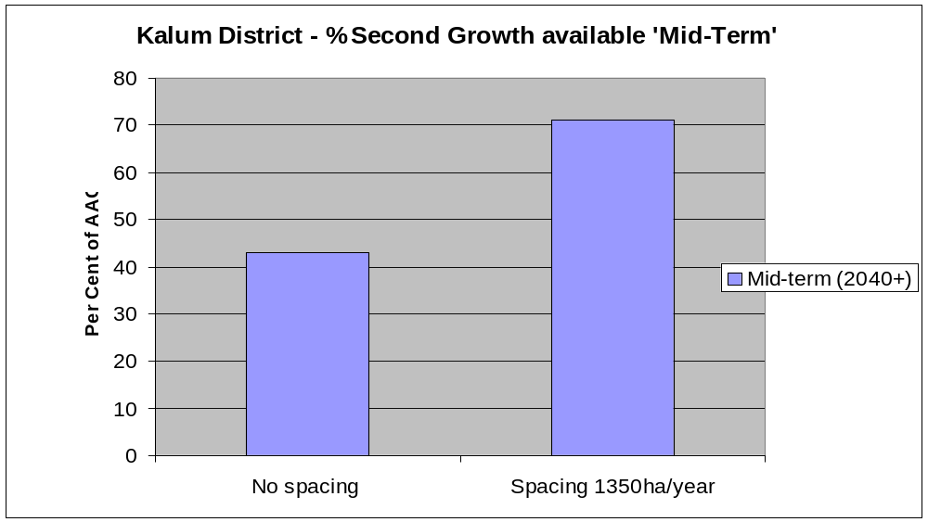
The majority of second-growth timber is densely stocked and will not be viable for harvest for decades unless stand tending is carried out in the near future to accelerate stand merchantability

Slide 9
The current harvesting of spaced second growth stands will compound the decline in mid-term AAC
To avoid a dramatic and sustained drop to mid-term economic AAC, incremental spacing of second growth stands is required

Slide 10
Considerable incremental silviculture treatments, particularly precommercial thinning, have been carried out within the Kalum TSA (as well as neighboring TFLs) from the 1970s to the 1990s
In recent years, area spaced has declined due to limited funding, although some treatment has continued through the JOP initiative, and with limited FIA funding. Year 1 of LBIS spacing program accomplished 300 ha
Past and current spacing programs have treated many of the candidate stands along active and passable roads. Much of the remaining spacing inventory is located in areas without active harvesting operations and cannot be accessed due to deactivated and deteriorating roads (15+ yrs old)
A line item in Timber Supply Mitigation budget is needed to allow for upgrading access to reach candidate stands for spacing.

